Slide 1
Transactions
CMPE 2400
Databases

Slide 2
Purpose
transactions are used to guarantee that no changes will occur within a database unless all intended changes within a set of SQL statements have been completed successfully.

Slide 3
Purpose
Banking Example
  If you deposit a cheque into an account, there are two distinct actions that must take place for the overall transaction to be successful.
    The account from which the cheque was written must be debited for the amount of the cheque.
    The account into which the cheque is being deposited must be credited for the amount of the cheque.

Slide 4
Purpose
Banking Example Problem
  If there is an error in the debiting process, and the crediting process still proceeds, then money has been created out of thin air.
  If there is an error in the crediting process after the debiting process has successfully completed, then money has been spontaneously destroyed.

Slide 5
Purpose
Banking Example Problem Result
  If the system is not bulletproofed against such errors, then confidence in our electronic banking system is destroyed as it causes an uncertainty in the value of our currency.
  The banks would eventually fail under a lack of confidence as clientele flees to protect themselves and their hard earned savings.
    Though this is not the cause of the recent financial sector meltdown, the result would be similar.

Slide 6
Purpose
Banking Problem Resolution
  We need a system that will be able to ensure that if either the debiting action fails or the crediting action fails, then no changes will be made at all.

Slide 7
transactions
In SQL, transactions were made especially for the purpose of preserving data integrity.
  This means that in order for any changes to be permanently made within the database, all changes proposed within a transaction must be able to complete successfully.

Slide 8
transactions
Up until this point, we have used autocommit transactions.
  This means that every SQL statement has been a transaction unto itself with two possible outcomes.
    The statement completes successfully, and is thus pushed into the database.
    The statement fails, and is automatically prevented from making any changes to the database.
  You may witness this happening by attempting to insert a row into a table with a value that has an illegal data type for the target column.
    The row will not be partially inserted. Thus, either the entire statement is correct, or it entirely fails.

Slide 9
transactions
Now, we will explicitly group several SQL statements into a single transaction.
  transactions may be used in global space with normal queries, but more often, we will see them used inside stored procedures.
    Note that data validation checks should not be included within a transaction as they are not performing any changes to the stored data.

Slide 10
transaction Syntax
A transaction will proceed as follows:
  begin the transaction.
  Complete a single action which changes the state of the database.
  Check for error occurrence in the action using @@error.
    If there are no errors, proceed to the next action.
    If an error has occurred, rollback all changes.
      If the transaction is embedded in a procedure, exiting the procedure at this point would be most efficient.
  If all actions complete successfully, commit the changes to the database.

Slide 11
transaction Syntax
begin tran[saction]
  -- first action that causes data change
  if @@error <> 0
  begin
  rollback tran[saction]
  return 1
  end
  -- second action
  if @@error <> 0
  begin
  rollback tran[saction]
  return 2
  end
  -- third action, etc.
  if @@error <> 0
  begin
  rollback tran[saction]
  return 3
  end
  commit tran[saction] -- All actions must be successful to reach this point
  return 0
  go

Slide 12
transaction Example
Return to your username_Referees database.
  We will first attempt to insert a new referee into the MoreRefs table, allowing the identity property of the RefID column to do its job.
  Next, assuming that the first insert was successful, we shall extract the automatically generated RefID so that the exact same record may be inserted into the Refs table. We shall use the first of the following two methods for extraction.
    Embed a subquery in the second insert statement.
    Save the value of @@identity to a variable and use it in the second insert statement.

Slide 13
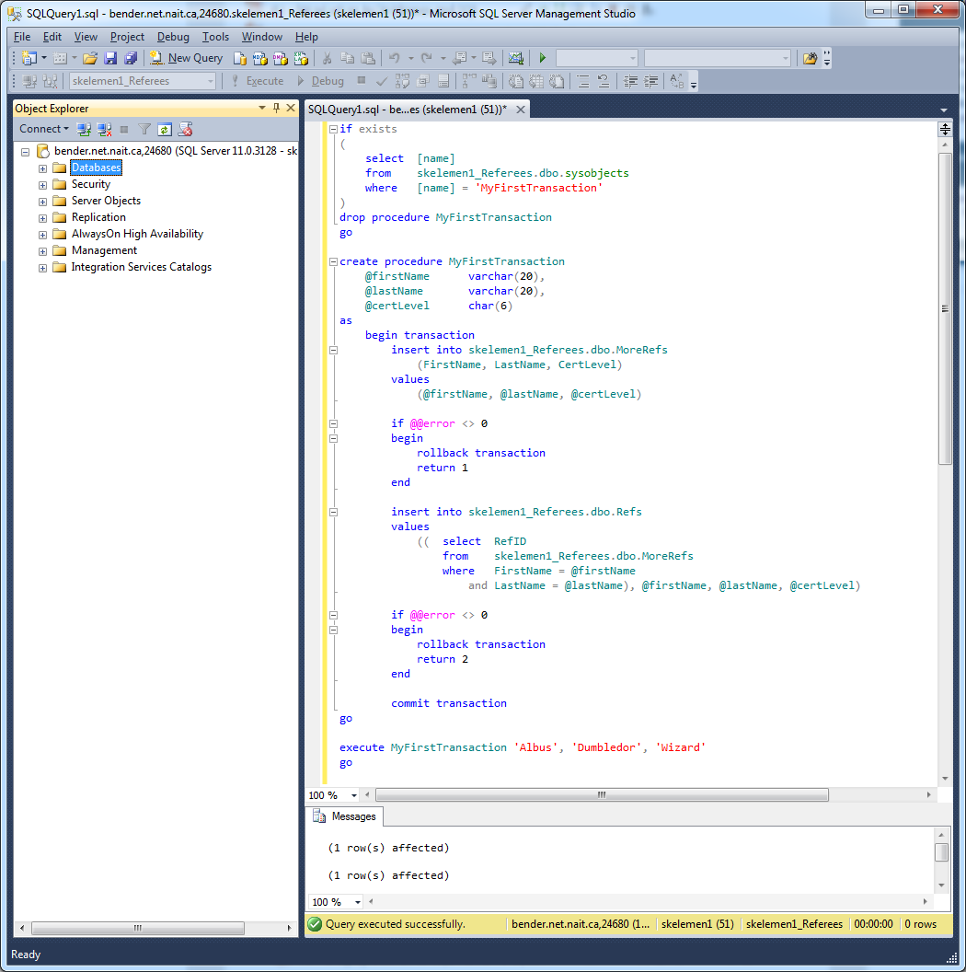
transaction Example

Slide 14
transaction Adjusted Example
Return to your username_Referees database.
  Now try to perform the same tasks, but this time do them in reverse.
    This will mean that you will need to specify a RefID as a parameter to the procedure and adjust the first insert statement to accommodate.
    Also, if you provide a RefID value that already exists in the Refs table, your first insert statement will fail. You should be able to verify that no records were added to either table with that execute of the procedure.

